Slide 1

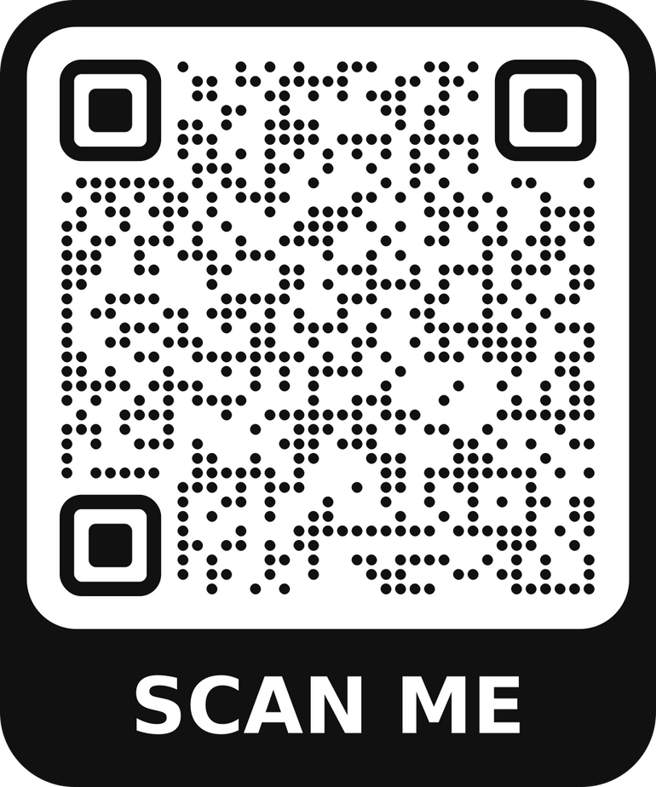
Discover more at www.horshamct.org.uk

Slide 2
Wed 3rd Sept, 7:30pm - 9pm
Prayer meeting at Kingdom Faith
Thurs 4th Sept, 10am
Prayer meeting at St Mary’s, Horsham
Thurs 4th Sept, 1pm - 2pm
Prayer meeting at St Mark's Church
Thurs 4th Sept, 7:30pm - 9pm
Prayer & Worship at St John’s, BBH
Sun 7th Sept, 9pm - 10pm
Prayer & Praise at Trafalgar Road Baptist

Slide 3
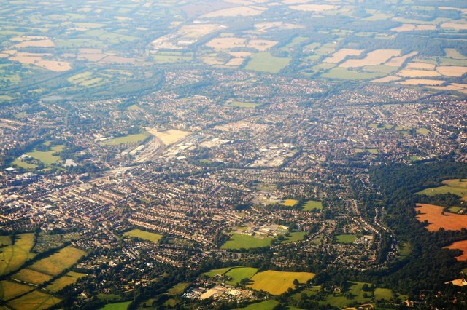
Horsham Virtual
Prayer Room
Find us on Facebook

